Slide 1
National Hydrogen Regulatory review
National Codes of Best Practice Co-design workshops
DCCEEW.gov.au

Slide 2
Acknowledgement of Country
I acknowledge the Traditional Custodians of the various lands across Australia from where we meet today.
Notes:
We acknowledge this land that we meet on today is the traditional lands for the Kaurna people and that we respect their spiritual relationship with their country.
We also acknowledge the Kaurna people as the custodians of the Adelaide region and that their cultural and heritage beliefs are still as important to the living Kaurna people today.
We also pay respects to the cultural authority of Aboriginal people visiting/attending from other areas of South Australia/Australia.
We acknowledge the Traditional Custodians of Country throughout Australia, and recognise their continuing connection to this land, its waterways, and the stars in the sky, since time immemorial. It is a privilege to pay respect to their Elders, knowledge holders, and to all the generations of First Nations’ peoples who have nurtured their unceded sovereign lands for over 80,000 years and continue to do so today.

Slide 3
Agenda
First half | 1300 – 1530
Introduction Background Overview of the information for participants | 1300-1315
Code Scope - description - components and processes - legislative themes | 1315-1430
Half-time wellbeing break | 1430 – 1445
Second half | 1445 -1600
Code Details Relevant Regulatory obligations and best practice Pt 1 | 1445 – 1530
Code Details Relevant Regulatory obligations and best practice Pt 2 | 1530 -1600
Close | 1600
Notes:
Original agenda that was circulated broke the day into hydrogen production and hydrogen refuelling. Like the codes, adaptable and flexible, we think the best approach today is going to be breaking the day into 2 parts, Code Scope and then regulatory obligations and best practice. There are a number of reasons for this, including that participants are not separate for both, and that legislative obligations are likely for similar for most part.
Today, we will not do introductions around the room, however, would like to introduce the members of the national regulatory review working group that are with us today. Qld government, which is hosting us today- Bronwyn, Kate, Natasha. we have the national reg review project team, Tom, me.

Slide 4
Background
Very Briefly

Slide 5
Timeline to today
Commitment under the National Hydrogen Strategy 2019
Commenced 2021
National industry and regulator consultation 2022
Preliminary findings August 2022
Priority reform measures announced February 2023

Slide 6
Priority projects to address identified barriers
Development and delivery of 5 National Hydrogen Codes of Best Practice
National Code of Best Practice Hydrogen Production
National Code of Best Practice Ammonia Production
National Code of Best Practice Hydrogen Refuelling
National Code of Best Practice Hydrogen Appliances
National Code of Best Practice Ammonia Appliances
Prioritise transport regulatory reform.
Working with transport ministers to develop efficient regulatory pathways for the importation, sale, operation, maintenance and modification of hydrogen fuelled vessels and vehicles and hydrogen and ammonia as a transport cargo. Including developing interim, streamlined exemption processes pending regulatory reform.
Standardisation of best practice
for use in:
The 5 National Hydrogen Codes of Best Practice.
AND
Prioritisation project for hydrogen and ammonia fuelled vessels and vehicles, and hydrogen and ammonia as a transport cargo.

Slide 7
Overview
Background information for participants

Slide 8
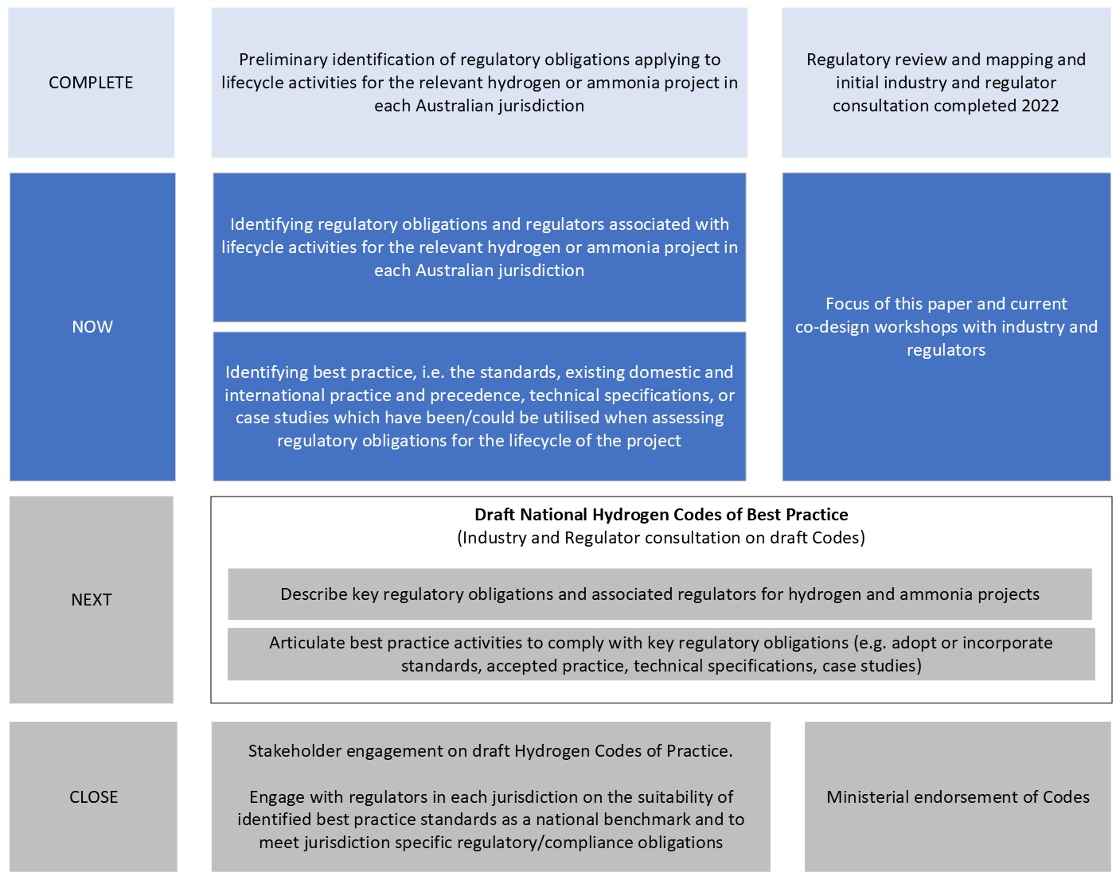
Development of National Codes of Best Practice
Notes:
This is visual image of the process we are now engaged in. To note, the original regulatory review was done at a much higher level than the process we are now engaged in, While we understood thematically where the gaps and barriers were, it is now in drafting the codes that we have to drill down into the very granular, line by line, regulatory obligations.

Slide 9
National Codes to improve:
Safety
National consistency
Transparency
Efficiency
Certainty
Regulatory obligations
Identifying regulatory obligations, and regulators associated with the lifecycle activities of the relevant hydrogen or ammonia project in each Australian jurisdiction.
Best practice
Identifying best practice, including existing domestic and international practice and precedence, technical specifications, case studies and standards which have been/could be utilized when assessing regulatory obligations for the lifecycle of the project.
Coordination
Identified best practice will be endorsed and utilised by all relevant regulators within each jurisdiction.
Notes:
A reminder of what we intend to achieve with the national codes.

Slide 10
- Assist industry understand how activities would demonstrate compliance with regulatory obligations (and provide confidence in the timing and cost of compliance)
- Assist regulators determine what would be acceptable for granting approvals or enforcing compliance with regulations

Slide 11
Relevant regulatory obligations
(reminder from your workshop pre-reading)
Regulatory obligations that are specific to hydrogen or require a hydrogen specific standard to demonstrate compliance.
Regulatory obligations of a general nature that are more significant in their application to the hydrogen industry than most other sectors
Regulatory obligations of a general nature that equally apply to hydrogen industry and other projects but there may be limited understanding of how the obligations apply to the hydrogen industry because no or a limited number of projects have been progressed (i.e., because it is new/nascent).
What are hydrogen specific regulations?
Regulations that specifically refer to hydrogen such as the transport of hydrogen as cargo or regulation of hydrogen fuel cell vehicles
Regulatory obligations that arise due to the nature of the facility producing or using hydrogen which are generic in nature but require a hydrogen specific standard or measure of best practice to demonstrate compliance with the obligation. For example, waste emissions, air and water from an electrolyser, or the approval of an electrolyser as an appliance, plant or equipment.
What are relevant regulations of a general nature?
Regulatory obligations that arise due to the nature of the facility producing or using hydrogen but are not necessarily only specific to hydrogen: regulatory obligations that are a relevant, important or essential part of a hydrogen project.
There is a new or different application of the regulatory obligation to hydrogen (e.g., because of new use or increased scale) and there is uncertainty in the practical or operational application of regulatory obligations. For example, regulation (such as waste) from a water purification plant. While water purification is not unique to hydrogen production the significance and volume of water input makes regulation of water production highly relevant.
Regulatory obligations that are more general in nature but including the obligation in a single location or describing the obligation will provide transparency and assist industry and regulators understand how the obligation applies in the context of hydrogen supply chains.
Notes:
This session we are going to input against input document 4 on your tables.
We have split into two parts – Safety legislation, eg WHS, Gas and Electrical Safety, Pipelines and then Environment, planning and building and transport.
Encourage to fill in in accordance with your own experience/expertise so can focus on different parts.
These are the categories which we included in the information for participants pre-workshop documents. We have predicated input 4 – Relevant regulatory obligations against these ideas of what will be relevant regulatory obligations for the codes.

Slide 12
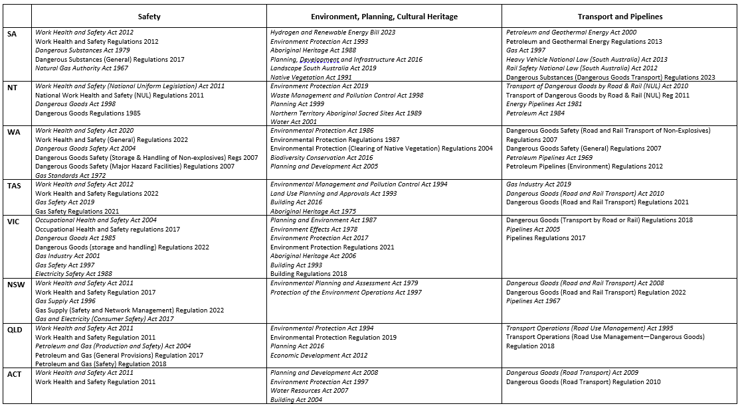
National examples of legislation with potential to contain relevant regulatory obligations

Slide 13
Best practice – what is it?
We are proposing that sources of ‘best practice’ may include the following:
Laws and regulations from other jurisdictions.
Technical work undertaken by publicly funded technical and research institutions to underpin hydrogen safety regulation (not yet law, regulation or standard)
A broader range of industry standards bodies to consider whether suitable standards are available, and where multiple standards are available, which is the ‘best’.
Case studies and examples of industry proponent developed ‘safety cases’ or ‘precedential novel regulatory approvals’.

Slide 14
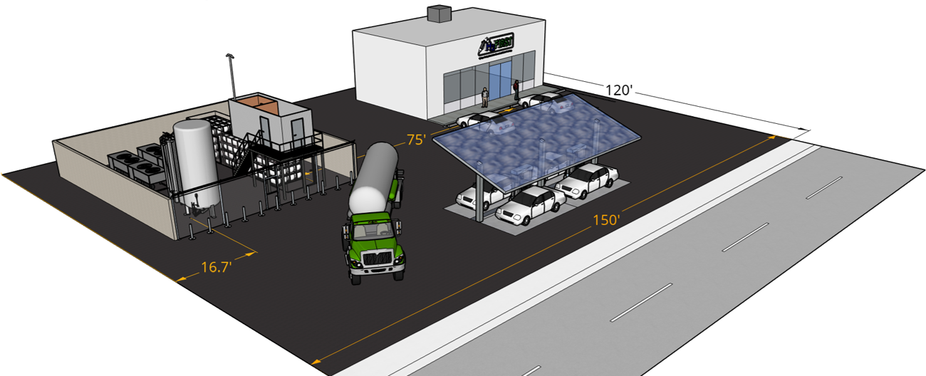
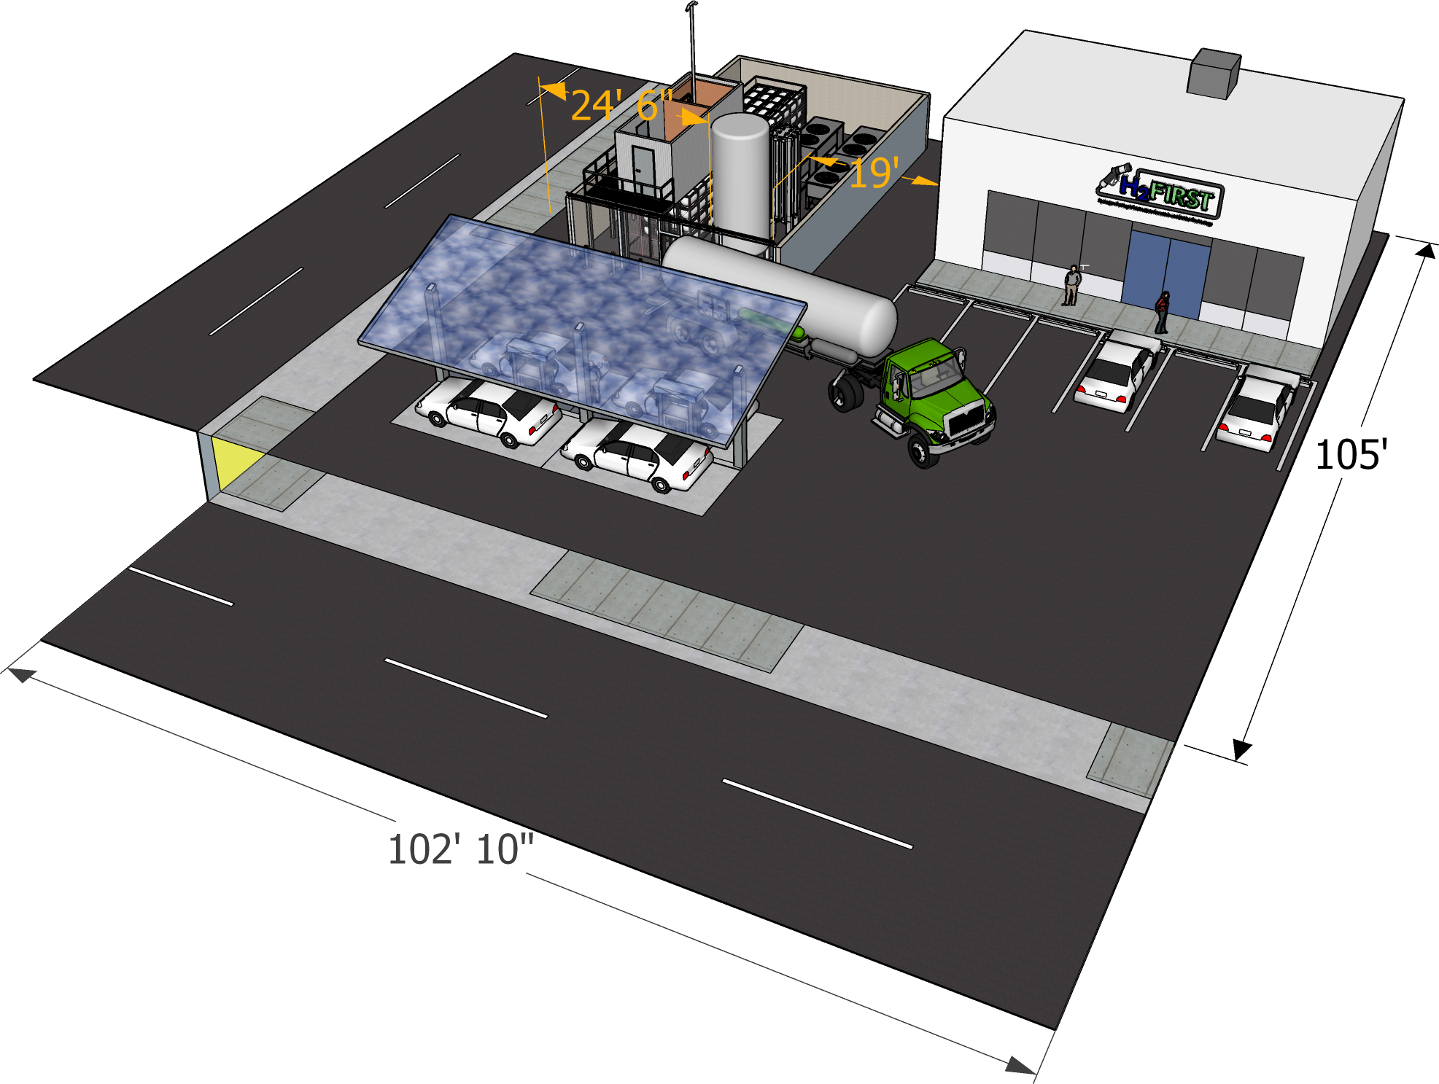
US Example of potential best practice opportunity
~40% Reduction In Separation Distances For Liquid Hydrogen (NFPA 2, 2023 Edition)
Previous (18,000 ft²)*
2016 Edition NFPA 2
Proposed (10,800 ft²)
2023 Edition NFPA 2
Distances based on storage volume
22 individual exposures (5 distances)
Non-repeatable basis
Distances now based on system pipe size & operating pressure
3 exposure groups
Well-documented, repeatable, revisable basis
*https://www.hydrogen.energy.gov/pdfs/19005_600kg_day_hydrogen_fueling_station_footprint.pdf
Notes:
In workshop documents for participants we included a list of potential examples. Today just providing a couple of visuals for reference. Questions for consideration are intended to be against all possible sources of best practice as originally described.

Slide 15
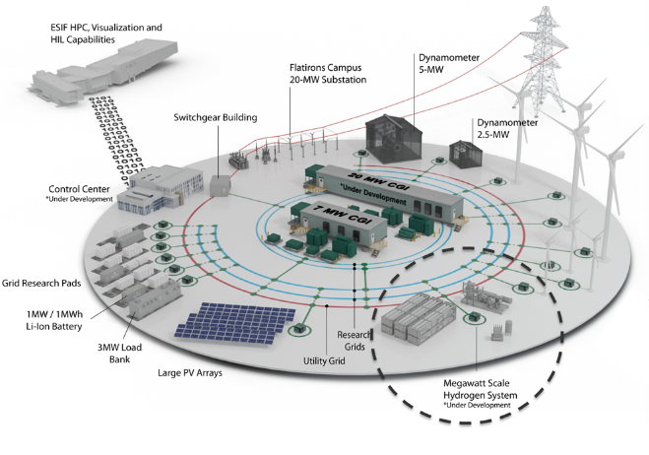
US example of potential best practice opportunity
Technical work being undertaken by National Renewable Energy Laboratory (NREL)
  Sensor Performance & Utilization
  Hydrogen Wide Area Monitoring
  Component Reliability and Safety
  Hydrogen Contaminant Detector
  PPB Sensor Validation Capability Development
  Hydrogen Emissions Measurements at ARIES
Notes:
What do we know about hydrogen detection equipment standards and utilisation
Highlight the sensor capabilities are part of the SCS program.

Slide 16
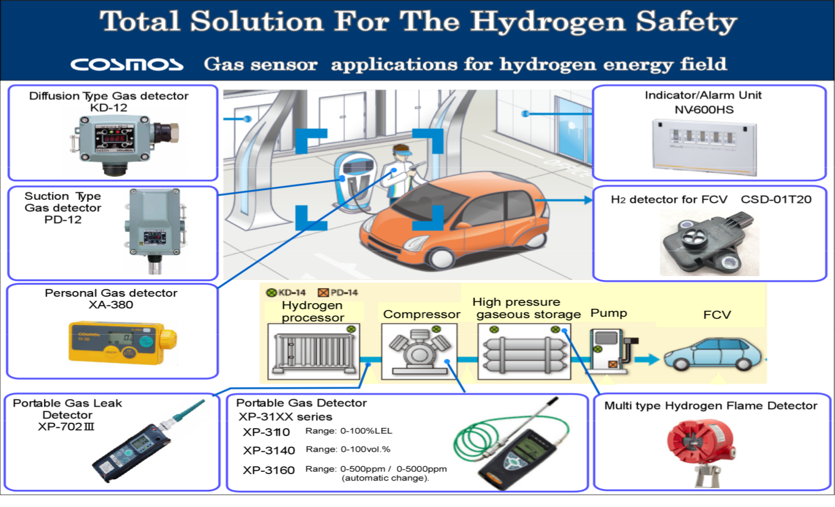
Vehicles and refuelling – Example company supplying detection equipment in an overseas market
Notes:
These slides provided as an example of safety cases that have already been prepared, and utilised in other jurisdictions, which we can utilise for national code of best practice. This hydrogen detection one is potentially of considerable interest. The Qld safety code – developed by some of our friends in the room discussion hydrogen detection as being the requirement given that odourisation is not possible. How can we streamline the acceptance of h2 detection equipment and in what scenarios?

Slide 17
4 key questions that we will work through in scope, regulatory obligations and best practice
What components or processes should be included in the project scope for each Code?
What regulatory schemes should be included in each of the Codes?
What are your regulatory experiences/challenges (approvals and compliance with particular regulatory provisions) applying the current regulatory framework?
What sources of best practice are you aware of that could address the specific regulatory issues that you have encountered/anticipated?

Slide 18
Code Scope
Description
Components and processes
Legislative themes
Notes:
First input part for the day. On tables, there are input documents for description, components and processes and legislative themes. Input documents 1, 2 and 3.
Each of these input documents approaches the code scope question from a different perspective
Input 1 – narrative description at a thematic level. If we were writing an introductory blurb, what would we say the hydrogen production facility code will cover?
Input 2 – from a component and processes perspective, ie activities perspective. This may help inform what would ultimately be included in a narrative description. What processes/activities do you want included in each code.
Input 3 – legislative themes perspectives. In this case important to remember that we are not writing codes for one act (like for example the WHS codes of best practice). We are writing codes that will cover off maybe 30 different pieces of legislation where they intersect with identified activities.

Slide 19
Feedback 1: Code Scope – descriptions
Are the current descriptions a useful mechanism to determine scope?
While the descriptions were useful for mapping the regulatory environment, do the descriptions work for the code process?
Should they include appliances, plant or equipment relevant to the nature of each proposed code?
Notes:
These questions for input for slides 14 and on your tables on printed forms entitle code scope descriptions.
Note that the production project description is a combination of the original production and appliances code proposals. For discussion.

Slide 20
Participant Feedback: Code Scope – descriptions
Are the current descriptions a useful mechanism to determine scope?
While the descriptions were useful for mapping the regulatory environment, do the descriptions work for the code process?
Should they include appliances, plant or equipment relevant to the nature of each proposed code?
Production
A hydrogen production facility project will include the production and storage of hydrogen, conversion into the form utilised for transport, and the transport of the final product to end users, for example:
Construction of a green or blue hydrogen production facility including planning approvals and the elements of detailed environmental assessments such as impacts on local community, potential hazards and risks, impacts on biodiversity, water (supply and use), quality and quantity, wastewater, stormwater management, erosion and sedimentation), waste generation and disposal, noise impacts, air quality impacts, traffic impacts.
Production of hydrogen (onshore and offshore), including equipment and handling approvals, environmental operating licences, major hazard facility licenses, pipeline licenses, water licenses, including WHS and skills/qualifications standards for these items.
Transport of Hydrogen to its end user via Rail, Road, Pipeline and Sea.
This code will include the safety and technical regulation of Hydrogen Appliances, Plant and Equipment used in connection with:
Green/Blue hydrogen production
Conversion of hydrogen (such as compression, liquefaction, metal hydride and ammonia production)
Storage of hydrogen or derivatives
End use, such as industrial heating, energy generation
Roundtable Discussion
Notes:
These are the original descriptions used for the archetypal hydrogen projects that we undertook the original regulatory review. It is useful to reflect on these for the purposes of filling out the first input document of the workshop – what is the coverage of the codes from a project perspective? Are these descriptions still appropriate as a starting point for scope? Within your table groups discuss the approach, potential inclusions/exclusions/separations. There is a place for writing your thoughts beside each code description on the input document.

Slide 21
Participant Feedback: Code Scope – descriptions
Are the current descriptions a useful mechanism to determine scope?
While the descriptions were useful for mapping the regulatory environment, do the descriptions work for the code process?
Should they include appliances, plant or equipment relevant to the nature of each proposed code?
Refuelling
A hydrogen refuelling project will include the transport and storage and dispensing of Hydrogen for the purposes of building a comprehensive transport network of refuelling stations, for example:
Transport of fuel to stations, including pipeline construction (greenfields), pipeline licencing (or authorisations) and road transport on tube trailer
Planning and Environment for refuelling facility
Bunkering (storage facility)
Hydrogen fuel cell bowser or dispensing equipment
Fuel quality standards, weights and measures standards
This code will include the safety and technical regulation of Hydrogen Appliances, Plant and Equipment used in connection with:
refuelling
Conversion of hydrogen (compression, liquefaction)
Storage of hydrogen or derivatives
Fuel quality, weights and measures
Roundtable Discussion
Notes:
These are the original descriptions used for the archetypal hydrogen projects that we undertook the original regulatory review. It is useful to reflect on these for the purposes of filling out the first input document of the workshop – what is the coverage of the codes from a project perspective? Are these descriptions still appropriate as a starting point for scope? Within your table groups discuss the approach, potential inclusions/exclusions/separations. There is a place for writing your thoughts beside each code description on the input document.

Slide 22
Feedback #2 - Code Scope- components and processes
Consider the groupings on the left of the input document. Are they useful/relevant to breaking up the codes into component parts?
Are the components and processes too broad, or too narrow? Are they ‘bundled’ in an appropriate way?
Are there components or processes that are missing? Should components and processes be included at a more granular level?
Notes:
These questions for input for slides 16 on your tables on printed forms.

Slide 23
Participant Feedback 2: Code Scope - Components and processes
 | Component / Process | Hydrogen Production | Refuelling Facility | Ammonia Production
Design | Design of a hydrogen production facility/refuelling facility (should include construction, operation and decommissioning)
Generic construction preparation | Preparatory civil construction works, e.g.: grading/levelling, drainage and flood control etc
 | Facilities for construction workforce (e.g. sewerage)
In-puts to facility | On-site renewable energy generation facility
 | Supply of electricity from grid by third party
 | CCS facility
 | Water supply
 | Telecommunication service
 | Derivative inputs, e.g. nitrogen for ammonia, CO2 for methanation
H2 Production | Construction of a hydrogen production facility
 | Operation of a hydrogen production facility/plant and equipment
H2 Refuelling | Construction of a hydrogen refuelling facility
 | Operation of a hydrogen refuelling facility
Plant and Equipment | Hydrogen production equipment
 | Hydrogen conversion equipment
 | Hydrogen (or derivative) Storage equipment
 | Hydrogen (or derivative) fuel dispenser
 | Ammonia plant
Conversion | Compressed H2
 | Liquefied H2
 | Ammonia
 | Methanol
 | Metal hydride
 | Liquid organic hydrogen carrier (LOH)
Storage | Compressed H2
 | Liquefied H2
 | Ammonia
 | Methanol
 | Metal hydride
 | Liquid organic hydrogen carrier (LOH)
Transport of hydrogen or derivatives | Road
 | Rail
 | Pipeline
 | Ship
Notes:
On your tables are printed versions of this table entitled input 2 – components and processes.

Slide 24
Feedback 3 questions: Code scope – Legislative sectors and themes
Are there any regulatory areas we have missed? Are they different for production or refuelling?
Are the legislative themes bundled appropriately? Are the groupings granular enough?
Can we remove any of these areas in their entirety? Eg culture and heritage, or site preparation activities
Are there any that should not be there? E.g., site preparation activities?
Notes:
Instead of considering scope by hydrogen project activities, these input documents gets us to think about it from a legislative framework perspective. This is useful because while legislation differs between jurisdictions, it is the case that different legislation is nevertheless addressing the same issues. These questions are for filling out the input document on your tables called input 3.

Slide 25
Input document 3: Code Scope - legislative sectors and themes
Safety | Environment, culture and heritage | Planning, development and building | Transport | Other
General work health and safety duties and obligations | Environmental impact assessment and approvals | Planning approval prior to commencement of work | Transport of a dangerous good by road, rail or sea | Telecommunications
Major hazard facilities licensing | Water supply licensing and approvals | Construction and building certificates | Pipeline licensing and obligations (outside of the National Gas Law) | Electricity supply and connection (supply from grid or on-site generation) grid connected or BTM (stand alone)
Hazardous chemicals obligations | Pollution and waste | Site preparation obligations | Design and construction of hydrogen equipment | Carbon capture and storage facilities
Gas facility licensing | Native vegetation clearing permits | Temporary construction obligations (e.g.: lay down, fencing, worker sewerage etc. | Port requirements for storage and handling of hydrogen | Geological storage of hydrogen
Gas pipeline safety | Taking or disturbing threatened species | Crown land and pastoral land tenure | UN Agreement Concerning the International Carriage of Dangerous Goods by Road | Creation of ACCUs and other GHG/Carbon reduction credits
Gas (including fuel gas) storage and handling | Aboriginal land rights, Sacred sites, protected sites and Aboriginal cultural heritage | Need for exclusion zones or buffers between facilities of different risk profiles and adjacent land use types | Australian Code for the Transport of Dangerous Goods by Road and Rail
Gas appliance licensing and obligations – key to national consistency. | Other heritage obligations
Notes:
Within your groups consider these legislative sector themes. Use the input document 3 to cross out, or add, legislative theme ideas.

Slide 26
Half-time wellbeing break

Slide 27
Relevant regulatory obligations and Best Practice
Including appliances, plant and equipment
Notes:
Talk to inclusion of appliances.

Slide 28
Input 4 questions: Relevant regulatory obligations and associated best practice.
What are the regulatory obligations within each of the identified legislative instruments.
What hydrogen project approvals (and components or processes of your hydrogen projects) have you sought to apply this obligation?
What are your experiences, challenges or lessons learned applying this obligation to your hydrogen projects (and components or processes) of your hydrogen projects?
What standards have you identified as relevant to complying with this obligation (e.g., assessing and mitigating risks associated with hydrogen project hazards)? Are you aware of alternative industry standards bodies that have particular and accepted expertise in our areas of interest?
Were there instances you relied on evidence other than recognised standards to demonstrate risk assessment processes or justify elimination/mitigation measures where other sectors would be able to refer to existing standards?
Do you have safety cases, processes that you have developed that you can share in this instance?

Slide 29
National examples of legislation with potential to contain relevant regulatory obligations

Slide 30
Participant Feedback - Regulatory Obligations & Best Practice: Safety
Relevant regulatory obligations What are the regulatory obligations relevant to hydrogen projects of which you are aware? What was unique or different about applying this obligation to a hydrogen project compared to another project? What are your experiences, challenges or lessons learned applying this obligation to your hydrogen activities? | Best practice What standards have you identified as relevant to complying with hydrogen regulatory obligations? Have you relied on evidence other than recognised standards to demonstrate risk assessment processes or mitigation measures? Do you have safety cases, processes that you have developed that you can share in this instance?
Approval for facilities storing greater than 50,000kg (triggering major hazard facilities approvals): Some of the main thresholds for hydrogen production and refuelling facility regulation are based on volume thresholds. For example, a major hazard facility applies to facilities with capacity greater than 50,000kg with notification required at 10% of the threshold (5,000kg). How do these volume thresholds relate to projects you are aware? | Best Practice Laws and regulations from other jurisdictions Technical work undertaken by publicly funded research institutions Case studies and examples of industry proponent developed ‘safety cases’ or ‘precedential novel regulatory approvals’. A broader range of industry standards bodies

Slide 31
Participant Feedback - Regulatory Obligations & Best Practice: Safety
Relevant regulatory obligations What are the regulatory obligations relevant to hydrogen projects of which you are aware? What was unique or different about applying this obligation to a hydrogen project compared to another project? What are your experiences, challenges or lessons learned applying this obligation to your hydrogen activities? | Best practice What standards have you identified as relevant to complying with hydrogen regulatory obligations? Have you relied on evidence other than recognised standards to demonstrate risk assessment processes or mitigation measures? Do you have safety cases, processes that you have developed that you can share in this instance?
Approval for facilities storing less than 50,000kg (e.g. triggering WHS notification and potential MHF determination at the 10% threshold): Are you aware of any upfront approvals for projects under 50,000kg storage capacity? What are your thoughts of the safety risks of the existing legislative volume thresholds? For example, are these thresholds appropriate for the emerging hydrogen industry with refuelling stations or other storage close to sensitive areas? | Best Practice Laws and regulations from other jurisdictions Technical work undertaken by publicly funded research institutions Case studies and examples of industry proponent developed ‘safety cases’ or ‘precedential novel regulatory approvals’. A broader range of industry standards bodies

Slide 32
Participant Feedback- Regulatory Obligations & Best Practice: Safety - Pipelines
Relevant regulatory obligations What are the regulatory obligations relevant to hydrogen projects of which you are aware? What was unique or different about applying this obligation to a hydrogen project compared to another project? What are your experiences, challenges or lessons learned applying this obligation to your hydrogen activities? | Best practice What standards have you identified as relevant to complying with hydrogen regulatory obligations? Have you relied on evidence other than recognised standards to demonstrate risk assessment processes or mitigation measures? Do you have safety cases, processes that you have developed that you can share in this instance?
Pipeline Safety Regulation For example: Licence to operate or construct a hydrogen pipeline, Risk assessments, safety case or other safety documentation supporting production facility approvals (where connected to a pipeline establishes connection with production facility regulation), General pipeline safety obligations that are not clear for hydrogen. Distribution or transmission licence | Best Practice Laws and regulations from other jurisdictions Technical work undertaken by publicly funded research institutions Case studies and examples of industry proponent developed ‘safety cases’ or ‘precedential novel regulatory approvals’. A broader range of industry standards bodies

Slide 33
Regulatory Obligations & Best Practice: Transport of hydrogen
Relevant regulatory obligations What are the regulatory obligations relevant to hydrogen projects of which you are aware? What was unique or different about applying this obligation to a hydrogen project compared to another project? What are your experiences, challenges or lessons learned applying this obligation to your hydrogen activities? | Best practice What standards have you identified as relevant to complying with hydrogen regulatory obligations? Have you relied on evidence other than recognised standards to demonstrate risk assessment processes or mitigation measures? Do you have safety cases, processes that you have developed that you can share in this instance?
Transport of hydrogen Regulation For example: Driver licensing, transport of dangerous goods by road or rail (compressed gas, refrigerated liquid, ammonia, methanol, fuel cell cartridges containing hydrogen in metal hydride). A vehicle is required to be licensed to transport dangerous goods when the vehicle is used to transport: dangerous goods in a receptacle with a capacity of more than 500 litres; or more than 500 kilograms of dangerous goods in a receptacle. | Best Practice Laws and regulations from other jurisdictions Technical work undertaken by publicly funded research institutions Case studies and examples of industry proponent developed ‘safety cases’ or ‘precedential novel regulatory approvals’. A broader range of industry standards bodies

Slide 34
Regulatory Obligations & Best Practice: Environment, Planning and Building
Relevant regulatory obligations What are the regulatory obligations relevant to hydrogen projects of which you are aware? What was unique or different about applying this obligation to a hydrogen project compared to another project? What are your experiences, challenges or lessons learned applying this obligation to your hydrogen activities? | Best practice What standards have you identified as relevant to complying with hydrogen regulatory obligations? Have you relied on evidence other than recognised standards to demonstrate risk assessment processes or mitigation measures? Do you have safety cases, processes that you have developed that you can share in this instance?
Environment, Planning and Building Regulation For example: Carrying out an activity that requires an environmental licence Approvals under the Environment Protection and Biodiversity Conservation Act (EPBC Act), waste management and pollution, water supply, obtaining planning and development approval prior to commencement of works, potential approvals relevant to the National Construction Code (NCC), construction or building certificates | Best Practice Laws and regulations from other jurisdictions Technical work undertaken by publicly funded research institutions Case studies and examples of industry proponent developed ‘safety cases’ or ‘precedential novel regulatory approvals’. A broader range of industry standards bodies

Slide 35
Regulatory Obligations & Best Practice: Other
Relevant regulatory obligations What are the regulatory obligations relevant to hydrogen projects of which you are aware? What was unique or different about applying this obligation to a hydrogen project compared to another project? What are your experiences, challenges or lessons learned applying this obligation to your hydrogen activities? | Best practice What standards have you identified as relevant to complying with hydrogen regulatory obligations? Have you relied on evidence other than recognised standards to demonstrate risk assessment processes or mitigation measures? Do you have safety cases, processes that you have developed that you can share in this instance?
Other Regulations Anything else? | Best Practice Laws and regulations from other jurisdictions Technical work undertaken by publicly funded research institutions Case studies and examples of industry proponent developed ‘safety cases’ or ‘precedential novel regulatory approvals’. A broader range of industry standards bodies

Slide 36
Thank you
Hydrogen Regulatory Review
A joint initiative of the Commonwealth and all state and territory energy ministers
email: nationalhydrogenregulatoryreview@dcceew.gov.au
Web links: https://www.dcceew.gov.au/energy/hydrogen
https://www.dcceew.gov.au/energy/hydrogen/regulatory-review

